Slide 1

Final Project (Bank Churners)
Zamri Afdal
Hassanudin
Ihdiani Ermis
Putri Caesa
Second Chance,
Group 2

Slide 2
Introduction :
This project is a part of Digital Skola Data Science project. We use different machine learning models to predict credit card churners based on a public dataset available on Kaggle.
Our focus :
Problem Understanding
Data Identification
Data Exploration and Visualization
Data Pre-processing
Machine Learning Modeling and Evaluation

Slide 3
Problem Understanding
What is the issue ?
Bank X detected a steep fall of credit card users which contributed significantly to their annual income. Retaining credit card user is vital to ensure their steady income through numerous fee charged from credit card transaction. Therefore, this analysis is used to help predict customers who are likely to churn based on their profile and transaction history. In addition, we will investigate most influential area that subjected for improvement.
Problem statement :
Will customer X stop using credit card based on his/her characteristic and transaction history ?

Slide 4
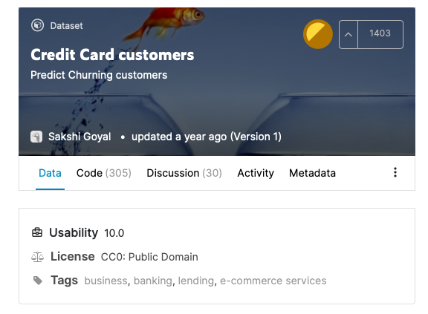
Flow chart :
Methodology
Step by step action taken :
Problem Identification
Data Collection
Kaggle : http://www.kaggle.com/sakshigoyal7/credit-card-customers
Investigate data basic information, data distribution, data visualization, and correlation
EDA
Labelling, encoding data, scaling, handling missing value/duplicate, and normalization
Data Pre-processing
Data spliting, model training, testing and evaluation
Modeling and evaluation

Slide 5
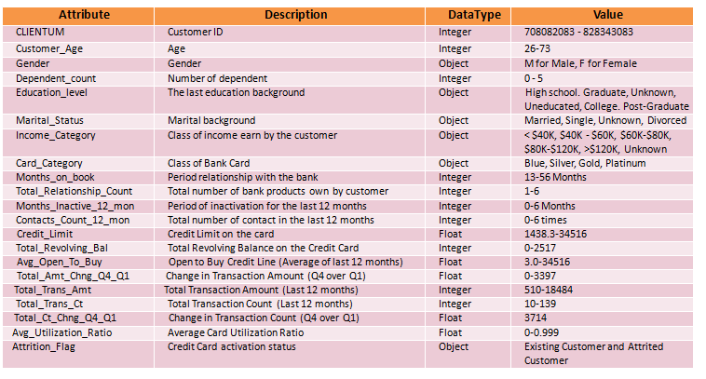
Exploratory Data Analysis
Data Understanding
Variable and Data Type

Slide 6
Exploratory Data Analysis
Data Preparation :
Group of Data | Input/Output | Name of the column/ feature | Problem and Quality
Personal Information | Input | CLIENTUM, Customer_Age, Gender, Dependent_count, Education_Level, dan Marital_Status | Education_Level and Marital_Status should be transformed into ordinal category (e.g 0-6). Define how we will treat the ‘Unknown’ value. No missing value.
Account Profile | Input | Income_Category, Card_Category, Months_on_book, Credit_Limit, Month_inactive_12_ mo, Contacts_count_12_mon | Credit_Limit is skewed to the left with outliers near 35.000. No missing value.
Transaction History | Input | Total_Revolving_Balance,Avg_Open_To_Buy, Total_Trans_Amt, Total_Trans_ct, Total_Amt_Chng_Q4_Q1, Total_Ct_Chng_Q4_Q1, Avg_Utilization_Ratio | Total_Revolving_Bal skewed to the left with spike at 0. No missing value
Target Variable | Output | Attrition_Flag | The variable is highly unbalanced, only a small proportion of the customers are churners (8500 vs 1627). The value should be transformed into binary 0 and 1

Slide 7
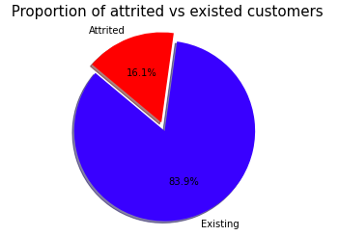
Exploratory Data Analysis
The pie chart shows the disproportion between existing and attrited customer 8500 (83.9%) vs 1627 (16.1%) respectively.
The dataset is distributed evenly amongst gender. Majority has university degree, married with income less than $40.000. Almost 90% of the customers are at the Blue tier of the card. When divided between attrtied and existed customers, the trends remain unchanged.

Slide 8
Exploratory Data Analysis
Points taken :
Most of the variables are not evenly distributed with outliers are detected in some variable
More than 2000 customers have zero credit balance and >2500 customer have not used their credit card
The change in transaction amount is normally distributed with mean 0.7
The total transaction amount in the last 12 months is greatly varied.
The change in the number of transactions is relatively stable through out quarters (0 to 1.5)

Slide 9
Exploratory Data Analysis
Points taken :
Majority of the customers had 2 or 3 dependents
The age of the customers are normally distributed
Majority used 3 or more bank service
Most of the accounts had been inactive for at least 3 months or less in the past 12 months
Most of the customers were contacted for 3 times in the past 12 months

Slide 10
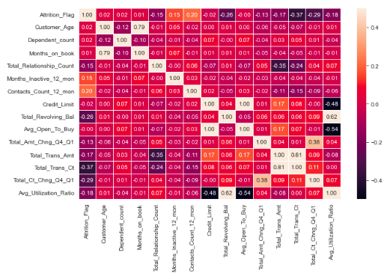
Data Pre-processing
No duplicates nor Null values
Filling the ‘unknown’ values in Education_Level and Income_Category with the mode
Convert categorical variable into numerical value using label encoder or one hot encoding for ordinal data
Drop unnecessary features
**Feature Selection : Due to perfect correlation between Avg_Open_To_Buy and Credit_Limit, we will choose Credit_limit to be included in our training model and drop Avg_Open_To_Buy accordingly**
Multicolinearity : Avg_Open_To-Buy has positive correlation
with Credit_Limit (r=1)

Slide 11
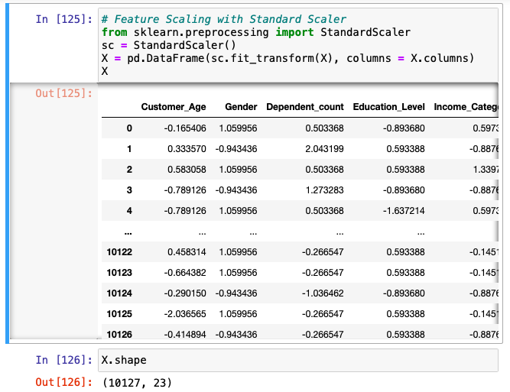
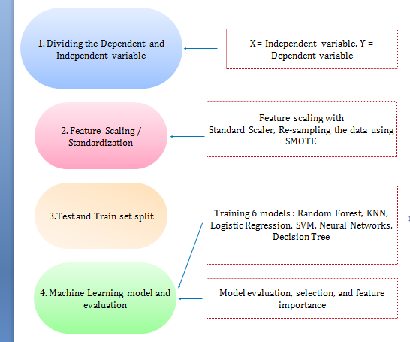
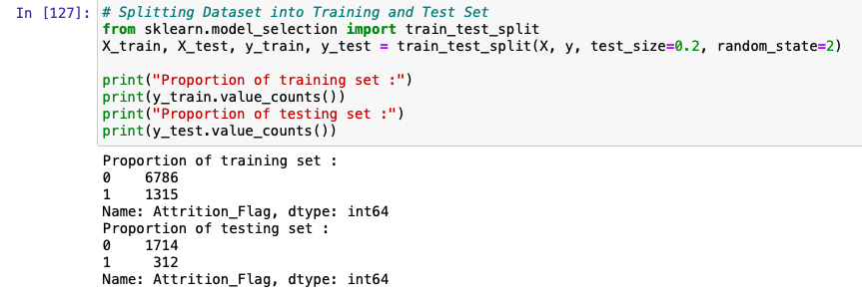
Machine Learning Modeling

Slide 12
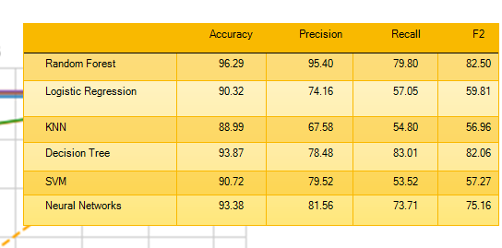
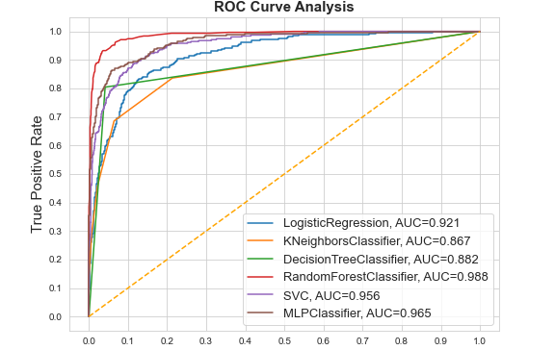
Machine Learning Modeling
Random forest is the best model with highest AUC = 0.988

Slide 13
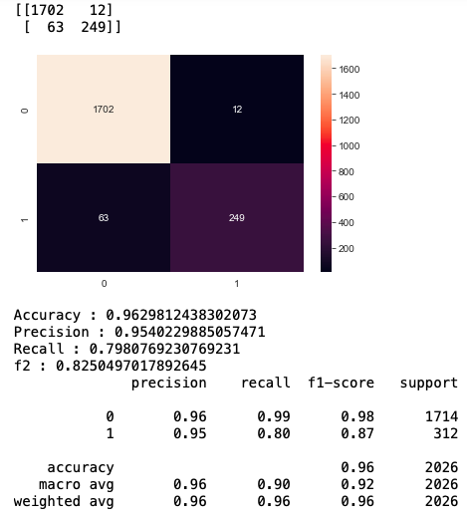
Machine Learning Modeling
Random Forest
Random Forest gives highest accuracy
Accuracy is not reliable parameter for imbalance dataset
Precision, Recall, and F-Beta as parameter
***With respect to our problem, it is best to choose a model that can give a high recall power***

Slide 14
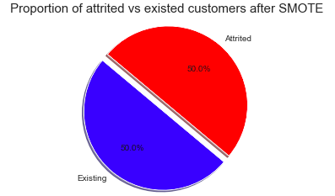
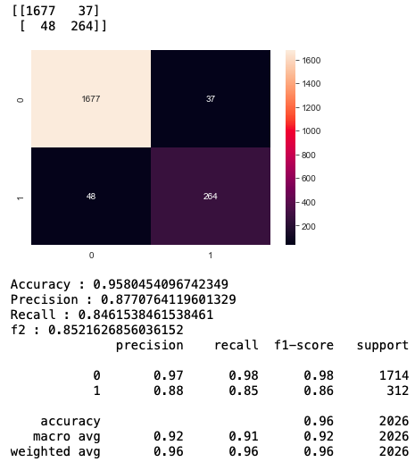
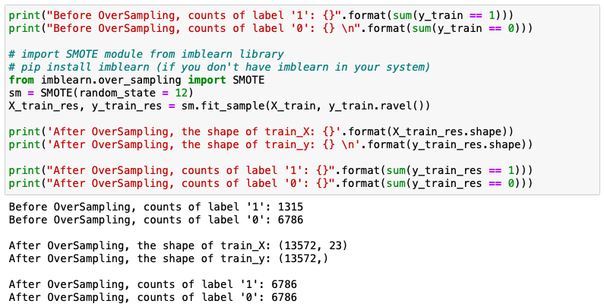
Machine Learning Modeling : SMOTE
Recall increases from 79.80 to 84.61
Precision decreases from 95.40 to 87.70
Accuracy decreases from 96.29 to 95.80
***The result of using SMOTE is generally an increase in recall, at the cost of lower precision***

Slide 15
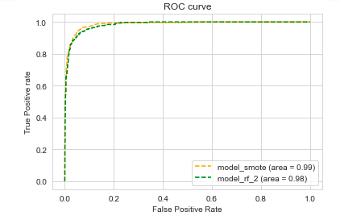
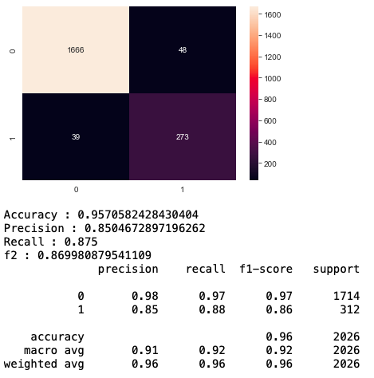
Hyperparameter tuning : Randomized Search
Best Estimator :
criterion : ‘entropy’
max_depth : 80
max_feature : ‘sqrt’
min_samples_split : 10
n_estimators : 20
random_state : 12
Recall increases from 84.61 to 87.50
Precision decreases from 87.70 to 85.04
Accuracy decreases from 95.80 to 95.7
**The two models are very good as the AUC score close to 1**

Slide 16

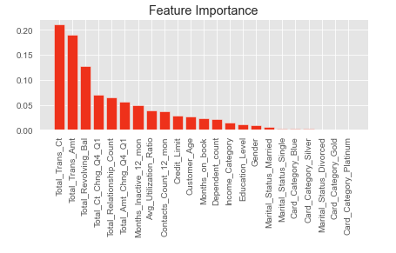
Feature Importance
Top 5 feature importance :
Total_Trans_CT
Total_Trans_Amt
Total_Revolvong_Bill
Total_Ct_Chng_Q4_Q1
Total_Relationship_Count

Slide 17
Thank you

